Slide 1



Simulation-Driven fNIRS using NIRFASTer: Modeling Hemodynamic Responses, Realistic Noise, and Diffuse Optical Tomography
Jiaming Cao¹ and Hamid Dehghani²
1. Centre for Cognitive and Brain Sciences,
Institute of Artificial Intelligence and Brain Sciences
University of Macau
2. School of Computer Science,
Center of Human Brain Health,
University of Birmingham, UK

Slide 2
Introduction to tissue optics & course overview
Basic theories behind forward data generation, including photon transport and parameterized HRF
How to generate forward models from segmented brain atlases and given optode montages using NIRFASTerFF
How to simulate realistic fNIRS signals given a desired activation location and HRF

Slide 3
Models of Light Propagation
Analytical Models
  Assumes Simple Homogenous Models
  Computationally fast
Stochastic Models
  Considered as most accurate
  Computationally Expensive
Numerical Models
  An approximation based on mathematical equations

Slide 4
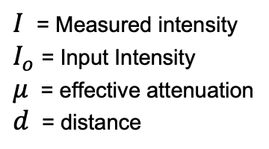
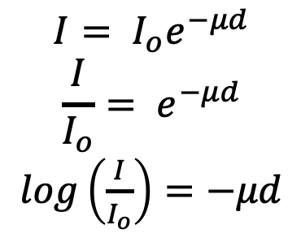
Analytical Models
In most simplest form, uses Beer-Lambert Law
$$I= I_{o}e^{−μd}$$
$$\frac{I}{I_{o}}= e^{−μd}$$
$log\left(\frac{I}{I_{o}}\right)=$ $−μd$
$I$= Measured intensity
$I_{o}$ = Input Intensity
$μ$ = effective attenuation
$d$ = distance
Slope
μ_{eff} = -(3μ_{a}μ_{s}/)^{1/2}
Log(Intensity)
depth

Slide 5
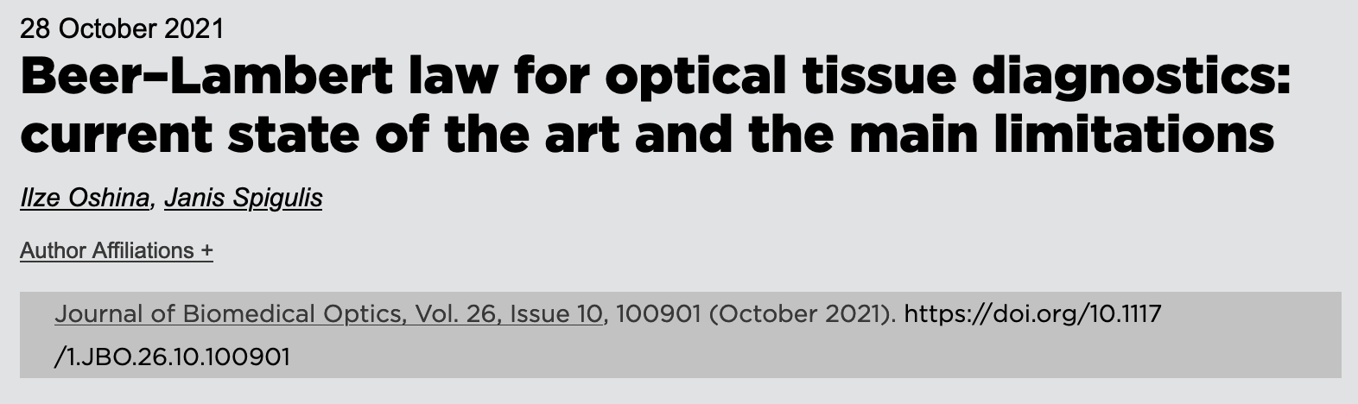
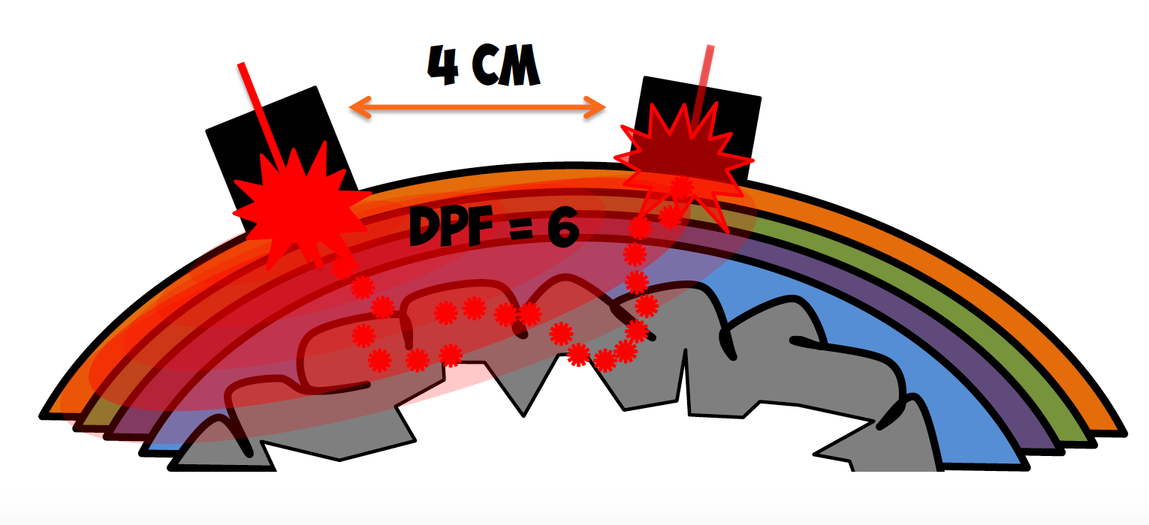
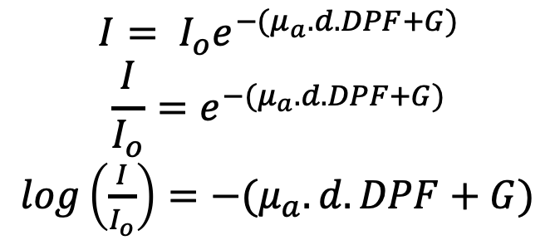
Analytical Models
Modified Beer-Lambert Law
$$I= I_{o}e^{−{(μ}_{a}.d.DPF+G)}$$
$$\frac{I}{I_{o}}=e^{−{(μ}_{a}.d.DPF+G)}$$
$log\left(\frac{I}{I_{o}}\right)=$ $−{(μ}_{a}.d.DPF+G)$
$I$= Measured intensity
$I_{o}$ = Input Intensity
$μ$ = effective attenuation
$d$ = distance
DPF represents the increase in the light pathlength due to scattering
G represents the scattering properties of the tissue

Slide 6
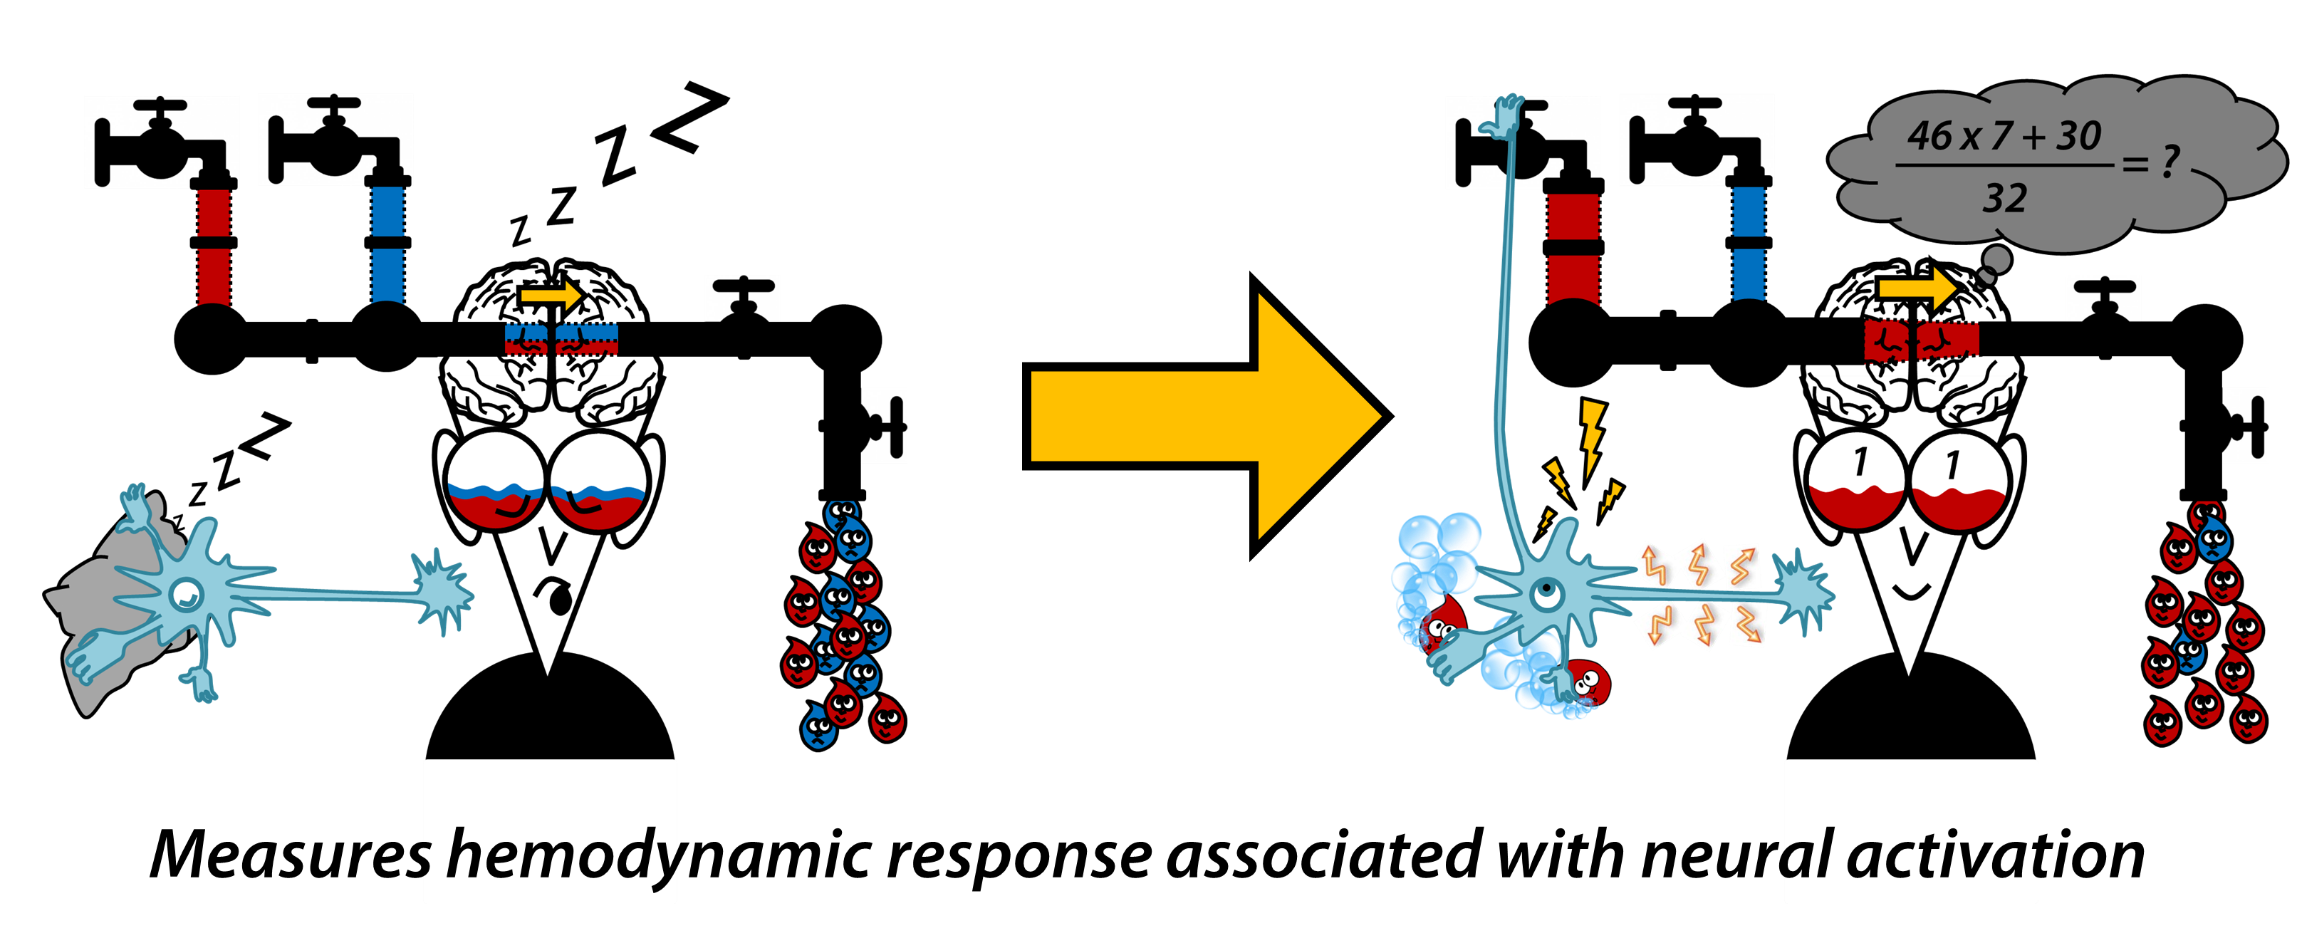
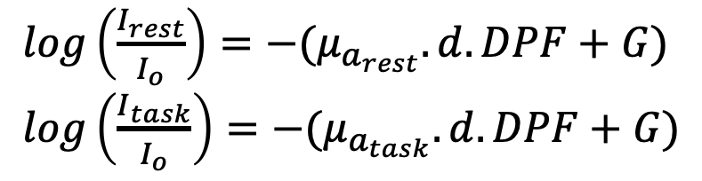
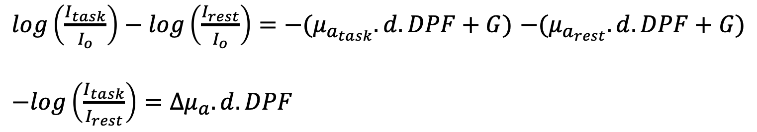
Analytical Models in fNIRS
$log\left(\frac{I_{rest}}{I_{o}}\right)=$ $−{(μ}_{a_{rest}}.d.DPF+G)$
$log\left(\frac{I_{task}}{I_{o}}\right)=$ $−{(μ}_{a_{task}}.d.DPF+G)$
$log\left(\frac{I_{task}}{I_{o}}\right)−log\left(\frac{I_{rest}}{I_{o}}\right)=$ $−{(μ}_{a_{task}}.d.DPF+G)$ $−{(μ}_{a_{rest}}.d.DPF+G)$
$−log\left(\frac{I_{task}}{I_{rest}}\right)=$ ${∆μ}_{a}.d.DPF$
Graphics by: Kevin Mandrick, Institut Supérieur de l'Aéronautique et de l'Espace (ISAE)

Slide 7
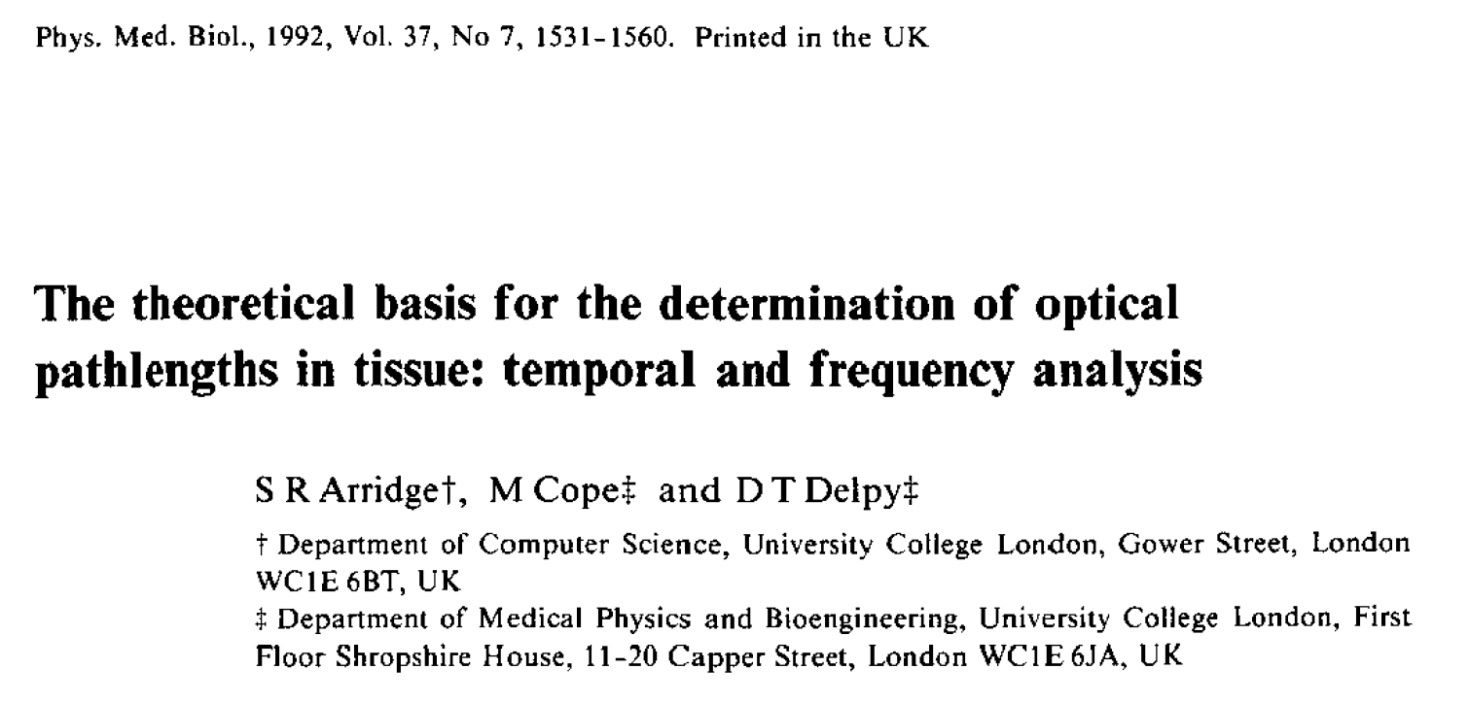
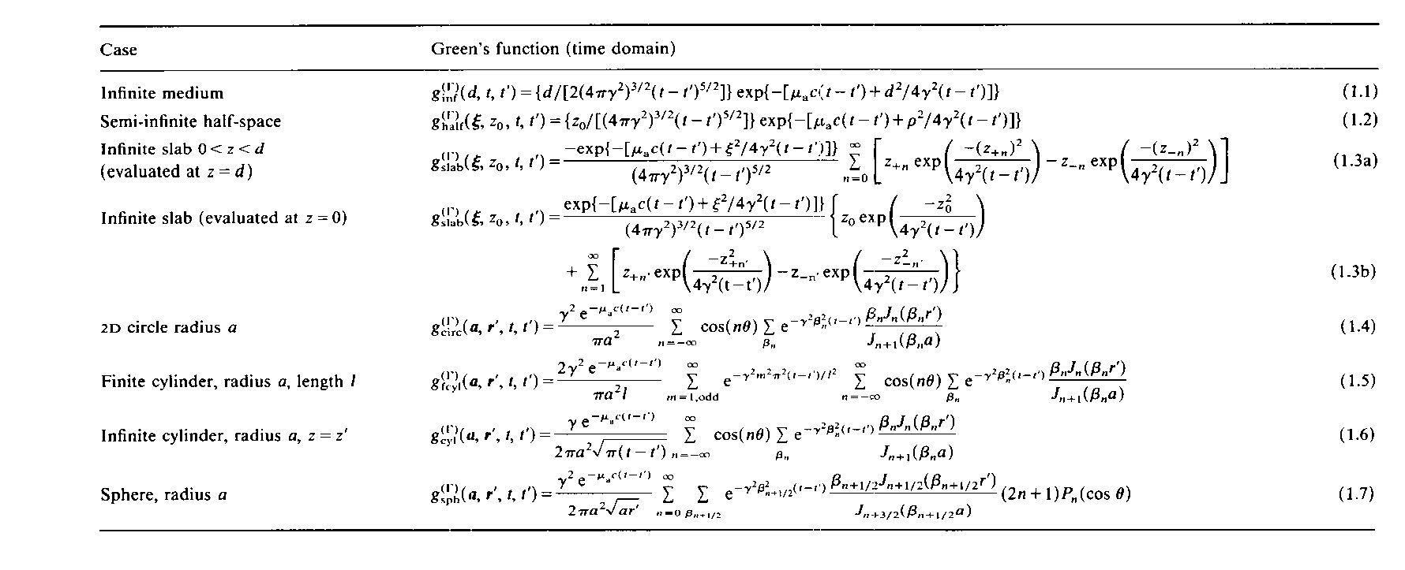
Analytical Models
More advanced work based on Green’s function of the diffusion approximation to the Radiative Transfer Equation
  Simple geometries with nearly homogeneous interior values
    Infinite
    Semi-infinite
    Cylinders
    Spheres

Slide 8
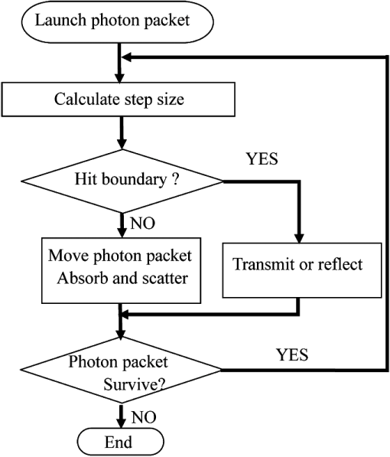
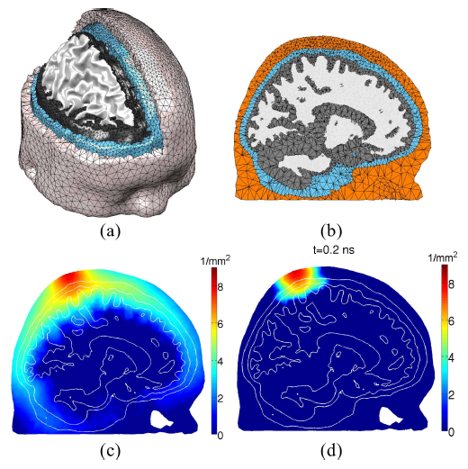
Stochastic Models
Monte Carlo models
  Initial works of Lihong Wang and Steven Jacques
    https://omlc.org/software/mc/
    Drop-dead simple MC
    Simple MC
    Fluorescent Monte Carlo
    Polarized Light MC
    MC for Multi-Layered
  Perturbation Monte Carlo (Intes)
  CPU/GPU based MC (Fang, Intes)
  Mesh-based MC (Fang)
Fang BioOpt Exp (2011)

Slide 9
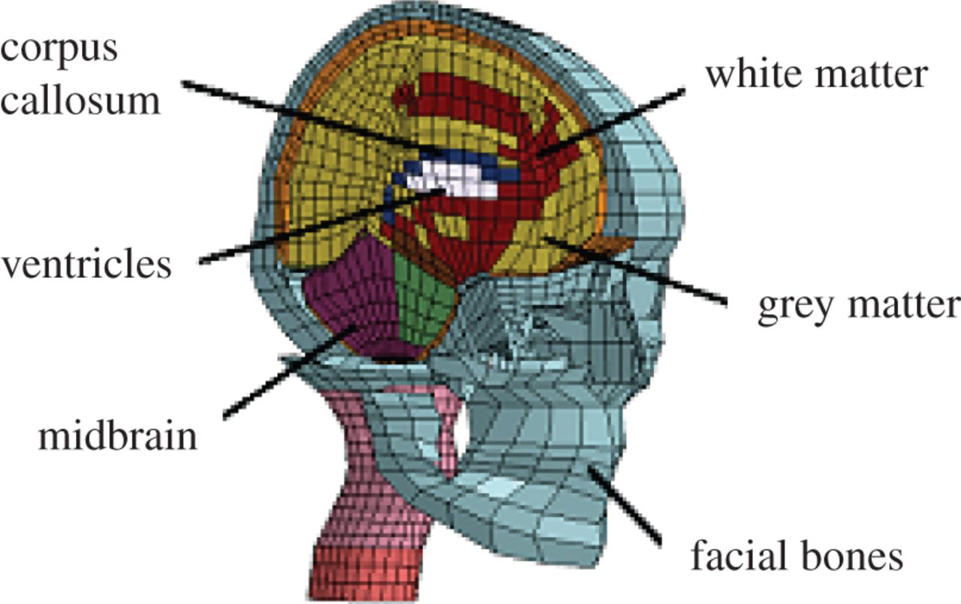
Numerical Models
Finite Elements
  Nodal based
  Element based
Finite Difference
  Nodal based
Finite Volume
  Volume around each element
Boundary Elements
  Only requires surface mesh
DOI: 10.1117/1.JBO.18.8.086007
DOI: 10.1098/rsif.2013.0914

Slide 10
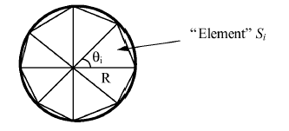
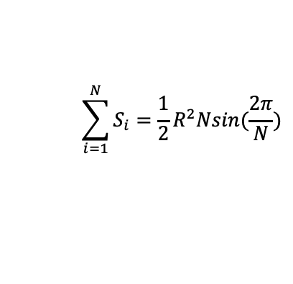
(very)
Basic idea of Finite Element Modelling
R
Area of circle:
Exact analytical solution: πR²
Approximate solution:
which equals exact solution as N tends to infinity
  i.e. infinitely small S_{i}
$$\sum_{i=1}^{N}{S_{i}=\frac{1}{2}R^{2}Nsin(\frac{2π}{N})}$$

Slide 11
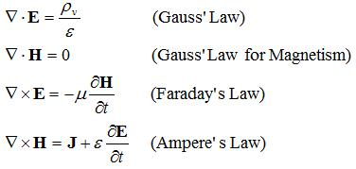
Modelling of light transport in tissue:
Maxwell’s Equation
A set of partial differential equations that, together with the Lorentz force law, form the foundation of classical electrodynamics, classical optics, and electric circuits.

Slide 12
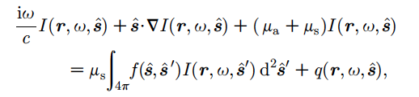

Radiative Transport Equation
Treating light as photons, and thus ignoring any wave effects, the propagation of light in tissue can be well described by the RTE
Source

Slide 13
Radiative Transport Equation
Treating light as photons, and thus ignoring any wave effects, the propagation of light in tissue can be well described by the RTE
Complex implementation within a numerical setting.
  use of an appropriate method for the incorporation of the angular dependence of the problem
    Discrete Ordinates (Lathrop, 1972; DANTSYS)
    Upwind difference scheme (Klose)
    Spherical harmonics expansion (Boas, Jiang)
    Simplified spherical harmonics (Klose, Chu)

Slide 14
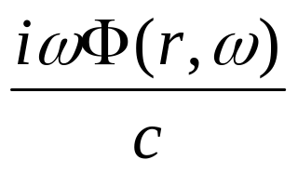

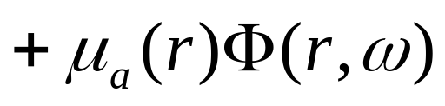
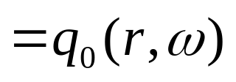

Diffusion Approximation
Light transport in tissue is turbid (scatter-dominated), modelled by diffusion equation:
Frequency
variation
diffusion
absorption
source
Boundary condition:
Field Φ: photon density, μ_{a} = Absorption Coefficient, κ = 1/3(μ_{a}+ μ_{s}`)
Dehghani et al, Applied Optics 2003

Slide 15
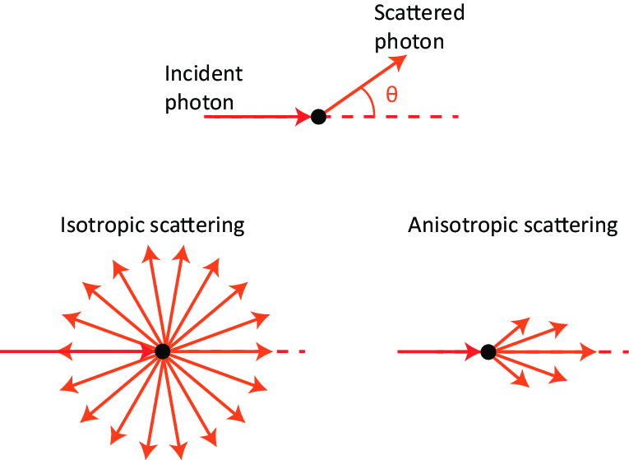
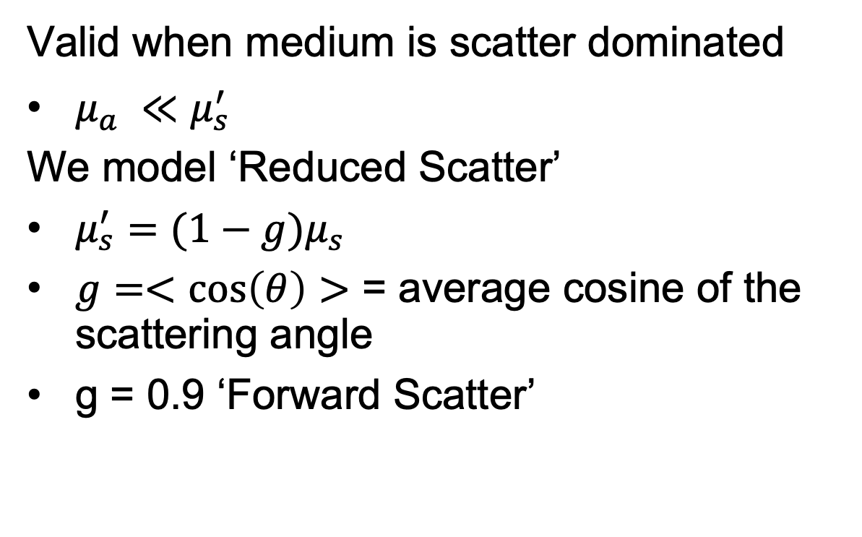
Diffusion Approximation
Valid when medium is scatter dominated
$μ_{a}^{}{≪μ}_{s}^{′}$
We model ‘Reduced Scatter’
$μ_{s}^{′}=(1−g)μ_{s}$
$g=<\cos\left(θ\right)>$ = average cosine of the scattering angle
g = 0.9 ‘Forward Scatter’

Slide 16
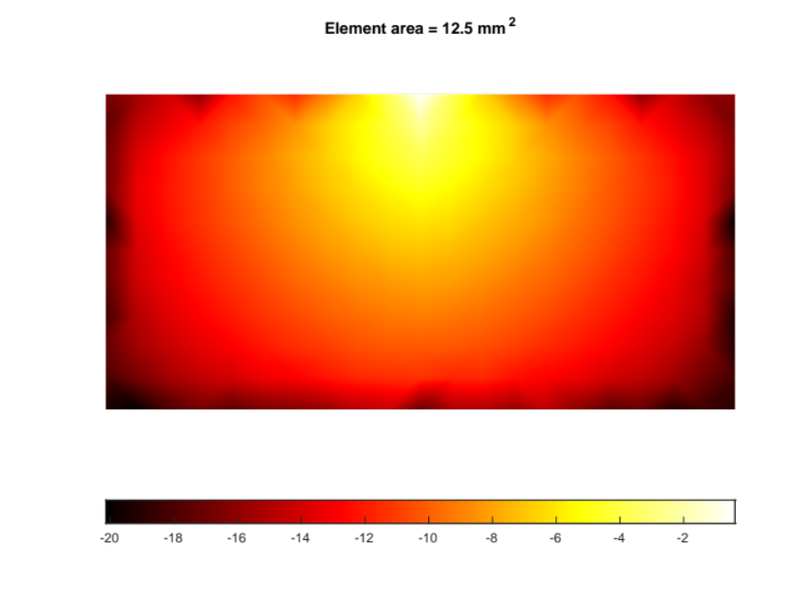
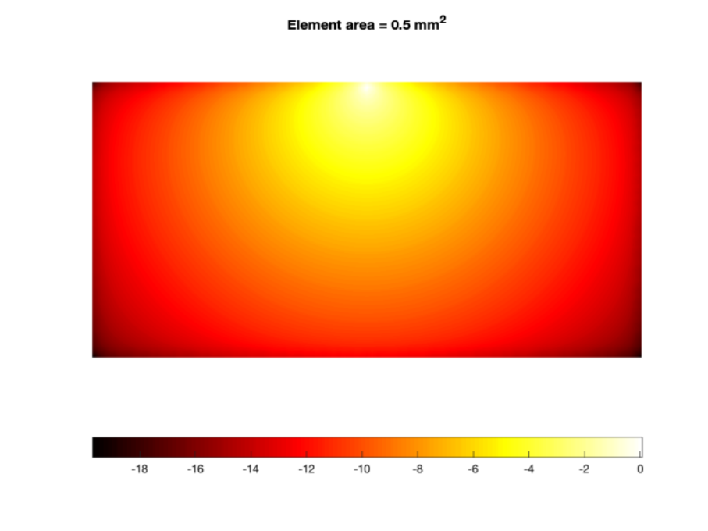

Diffusion Approximation
Solution is an approximation
  Error tends to zero as elements get smaller

Slide 17
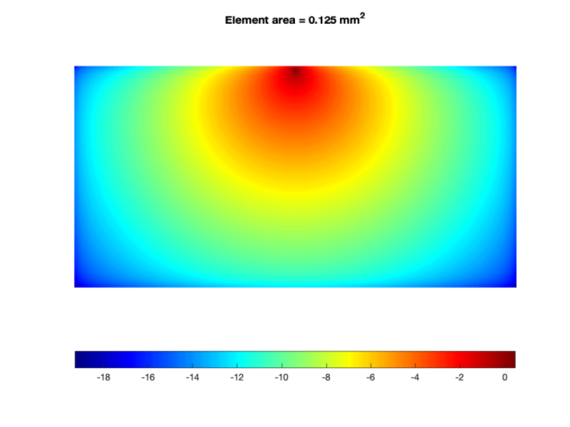
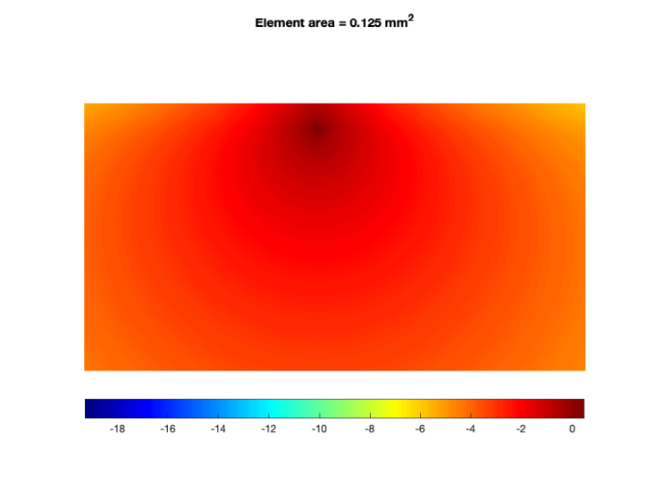
Diffusion Approximation
The source is modelled at 1 scattering distance inside tissue: 1/μ_{s}`
  Becomes isotropic at the surface

Slide 18
Questions?

